Slide 1
HNDIT2401 Computer Architecture
Week 2: Boolean Algebra & Circuit Simplification

Slide 2
Boolean Algebra
Formal logic: In formal logic, a statement (proposition) is a declarative sentence that is either true(1) or false (0). It is easier to communicate with computers using formal
Boolean variable: They are variables. Takes only two values – either true (1) or false (0). They are used as basic units of formal logic.
Boolean algebra: Deals with binary variables and logic operations operating on those variables.

Slide 3
Boolean Algebra………
Boolean Expressions: Combining the variables and operators yields Boolean expressions.
Boolean function: Mapping from Boolean variables to a Boolean value. A Boolean function typically has one or more input values and yields a result, based on these input values, in the range {0,1}
Truth table:
Represents relationship between a Boolean function and its binary variables.
It enumerates all possible combinations of arguments and the corresponding function values.

Slide 4
Boolean Algebra………….
• Logic diagram: Composed of graphic symbols for logic gates. A simple circuit sketch that represents inputs and outputs of Boolean functions.

Slide 5
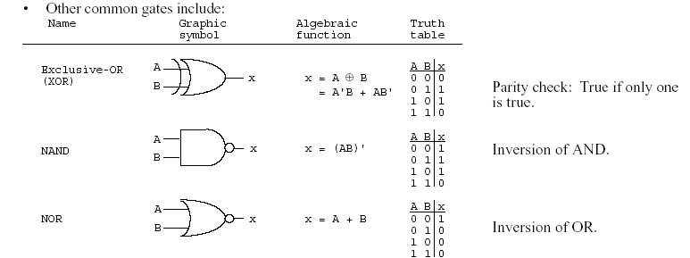
Boolean function and truth table

Slide 6
BASIC IDENTITIES OF BOOLEAN ALGEBRA
Postulate 1 (Definition): A Boolean algebra is a closed algebraic system containing a set K of two or more elements and the two operators · and + which refer to logical AND and logical OR
Notes:
Postulate -Hypothesize

Slide 7
Basic Identities of Boolean Algebra (Identity law/dominance (Null) law)
Identity law
x + 0 = x
x · 1 = x
dominance (Null) law
x · 0 = 0
x + 1 = 1

Slide 8

Basic Identities of Boolean Algebra (Idempotent Law / complement law)
Idempotent Law
(5) x + x = x
(6) x · x = x
complement law
(7) x + $\overline{x}$ = 1 / x+x’=1
(8) x · $\overline{x}$ = 0 / x.x’=0

Slide 9
Basic Identities of Boolean Algebra (Commutative law):
(9) x + y = y + x
(10) xy = yx

Slide 10
Basic Identities of Boolean Algebra (Associative law):
(11) x + ( y + z ) = ( x + y ) + z
(12) x (yz) = (xy) z

Slide 11
Basic Identities of Boolean Algebra (Distributive law):
(13) x ( y + z ) = xy + xz
(14) x + yz = ( x + y )( x + z)

Slide 12

Basic Identities of Boolean Algebra (DeMorgan’s Theorem)
(15) $\overline{(x+y)}$=$\overline{x}\overline{y}$ / (x+y)’=x’y’
(16) $\overline{x.y}$= $\overline{x}+\overline{y}$ /(xy)’=x’+y’

Slide 13

Basic Identities of Boolean Algebra (Double Complement Law/Involution)
(17) $\overset{̿}{x}$= x/ (x’)’=x

Slide 14
Basic Identities of Boolean Algebra

Slide 15
Function Minimization using Boolean Algebra
Examples:
(a) a + ab = a(1+b)=a
(b) a(a + b) = a.a +ab=a+ab=a(1+b)=a.
(c) a + a'b = (a + a')(a + b)=1(a + b) =a+b
(d) a(a' + b) = a. a' +ab=0+ab=ab

Slide 16
Try
F = abc + abc’ + a’c
Notes:
abc + abc’ + a’c
=ab(c+c’)+a’c
=ab(1)+a’c
=ab+a’c

Slide 17
The other type of question
Show that;
1- ab + ab' = a
2- (a + b)(a + b') = a
1- ab + ab' = a(b+b') = a.1=a
2- (a + b)(a + b') = a.a +a.b' +a.b+b.b'
= a + a.b' +a.b + 0
= a + a.(b' +b) + 0
= a + a.1 + 0
= a + a = a

Slide 18
More Examples
Show that;
(a) ab + ab'c = ab + ac
(b) (a + b)(a + b' + c) = a + bc
(a) ab + ab'c = a(b + b'c)
= a((b+b').(b+c))=a(b+c)=ab+ac
(b) (a + b)(a + b' + c)
= (a.a + a.b' + a.c + ab +b.b' +bc)
= …

Slide 19
DeMorgan's Theorem
(a) (a + b)' = a'b'
(b) (ab)' = a' + b'
Generalized DeMorgan's Theorem
(a) (a + b + … z)' = a'b' … z'
(b) (a.b … z)' = a' + b' + … z‘

Slide 20
DeMorgan's Theorem
F = ab + c’d’
F’ = ??
F = ab + c’d’ + b’d
F’ = ??

Slide 21
DeMorgan's Theorem
Show that: (a + b.c)' = a'.b' + a'.c'
Notes:
(a + b.c)' =a’.(bc’)’=a’.(b’+(c’)’)=a’b’+a’.c

Slide 22
More DeMorgan's example
Show that: (a(b + z(x + a')))' =a' + b' (z' + x')
(a(b + z(x + a')))' = a' + (b + z(x + a'))'
= a' + b' (z(x + a'))'
= a' + b' (z' + (x + a')')
= a' + b' (z' + x'(a')')
= a' + b' (z' + x'a)
=a‘+b' z' + b'x'a
=(a‘+ b'x'a) + b' z'
=(a‘+ b'x‘)(a +a‘) + b' z'
= a‘+ b'x‘+ b' z‘
= a' + b' (z' + x')

Slide 23
More Examples
(a(b + c) + a'b)'=b'(a' + c')
ab + a'c + bc = ab + a'c
(a + b)(a' + c)(b + c) = (a + b)(a' + c)

Slide 24
Karnaugh maps
Circuit Minimization
Algebraic manipulations can be used to simplify Boolean expressions
As we've seen, this process is not always easy
Karnaugh maps (K-maps) provide an easy and visual technique for finding the minimum cost Sum Of Product (SOP) (or Product of sum(POS)) form for a Boolean expression
This technique has limitations. i.e. works for # inputs < 7
Not good for CAD tools, but good for teaching the idea of simplification

Slide 25
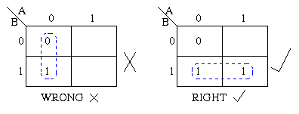
Rule for k map
Groups may be horizontal or vertical, but not diagonal.
Groups may not include any cell containing a zero
Rule for k map…………….

Slide 26
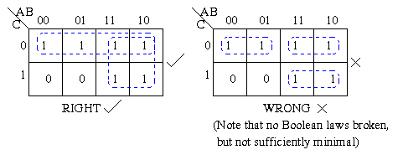
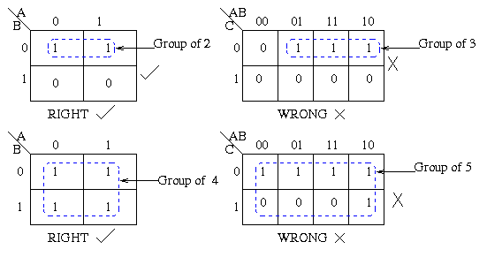
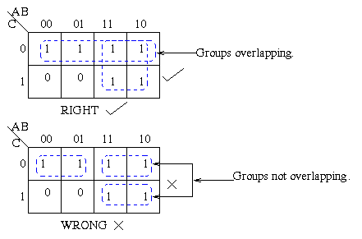
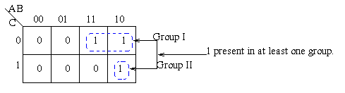
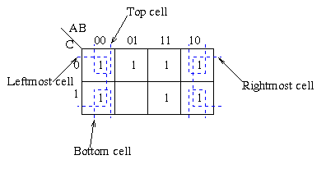
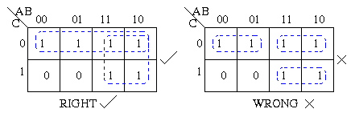
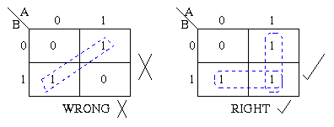

Slide 27
The Combining Property
Recall the combining property
x y + x y' = x (y + y') = x
Example:
f = x1'x2'x3'+x1'x2x3'+x1x2'x3'+x1x2'x3 = m0 + m2 + m4 + m5
A minterm is a Boolean expression resulting in 1 for the output of a single cell, and 0s for all other cells in a Karnaugh map, or truth table.
Minterms m0 and m2 differ in only one variable (x2)
m0 and m2 can be combined to get x1'x3'
Reduced fan in and reduced number of gates
Hence, f = x1'x3' + x1x2' ← still SOP but not canonical

Slide 28
Visualizing the Combining Property
f(x1,x2) = Σm(0,1,3)
Canonical SOP:
f = x1'x2'+x1'x2+x1x2 = x1'x2'+x1'x2+x1x2+x1'x2 = x1'+x2
A 2-variable Karnaugh map:
x1 | x2 | F
0 | 0 | 1
0 | 1 | 1
1 | 0 | 0
1 | 1 | 1
minimum form: f = x1'+x2
x2 x1 | 0 | 1
0 | 1 | 1
1 | 0 | 1

Slide 29
3 Variable Map
f(A,B,C) = Σm(1,2,6,7)
Minimum SOP is f = A B + B C' + A' B' C
Cost = gates + fan-in = 4 + (7+3) = 14
Gray Code: any two consecutive numbers differ in only a single bit
B C A | 00 | 01 | 11 | 10
0 | 0 | 1 | 0 | 1
1 | 0 | 0 | 1 | 1

Slide 30
K-maps in Various Sizes
B A | 0 | 1
0 | m₀ | m₁
1 | m₂ | m₃
B C A | 00 | 01 | 11 | 10
0 | m₀ | m₁ | m₃ | m₂
1 | m₄ | m₅ | m₇ | m₆
C D A B | 00 | 01 | 11 | 10
00 | m₀ | m₁ | m₃ | m₂
01 | m₄ | m₅ | m₇ | m₆
11 | m₁₂ | m₁₃ | m₁₅ | m₁₄
10 | m₈ | m₉ | m₁₁ | m₁₀

Slide 31
Full-Adder Carry-Out
Cout(A,B,Cin) = Σm(3,5,6,7)
Minimum SOP is Cout = A Cin + B Cin + A B
Cost = 4 + 9 = 13
B Cin A | 00 | 01 | 11 | 10
0 | 0 | 0 | 1 | 0
1 | 0 | 1 | 1 | 1

Slide 32
More 3 Variable Maps
B C A | 00 | 01 | 11 | 10
0 | 0 | 0 | 1 | 1
1 | 1 | 1 | 0 | 0
A' B + A B' (A ⊕ B)
f =
B C A | 00 | 01 | 11 | 10
0 | 1 | 1 | 1 | 1
1 | 0 | 0 | 1 | 1
A' + B
f =

Slide 33
And Even More 3 Variable Maps
B C A | 00 | 01 | 11 | 10
0 | 0 | 1 | 1 | 0
1 | 1 | 0 | 0 | 1
A' C + A C' (A ⊕ C)
f =
B C A | 00 | 01 | 11 | 10
0 | 1 | 0 | 0 | 1
1 | 1 | 0 | 1 | 1
C' + A B
f =

Slide 34
Full-Adder Sum
S(A,B,Cin) = Σm(1,2,4,7)
Minimum is S = A B' Cin' + A' B' Cin + A B Cin + A'B Cin'
Can't reduce anything and stay in SOP form!
B Cin A | 00 | 01 | 11 | 10
0 | 0 | 1 | 0 | 1
1 | 1 | 0 | 1 | 0

Slide 35
Sidebar: Gray Codes
A binary Gray code is a binary sequence such that no two consecutive numbers differ by more that a single bit
Gray codes have many uses in CS
2 bit Gray code: 00, 01, 11, 10
Note that this is circular → 10, 00 again differs in only 1 bit
These are called binary reflected Gray codes
3 bit Gray code: 000, 001, 011, 010, 110, 111, 101, 100

Slide 36
The Formal Karnaugh Map Method
Choose a 1 element
Find all maximal groups of 1's adjacent to that element
Note: "box" must be a power of 2 in size
Repeat steps 1-2 for all 1 elements
Select all boxes for which a 1 is “covered” by only that box
These boxes are essential!
For all 1's not covered by the essential boxes, select the smallest number of other boxes that cover them
In case of a choice, select the largest box!

Slide 37
4 Variable Maps
f(A,B,C,D) = Σm(0,1,2,3,6,8,9,11,13,14)
f = A C' D + B C D' + B' C ' + B' D + A'B'
C D A B | 00 | 01 | 11 | 10
00 | 1 | 1 | 1 | 1
01 | 0 | 0 | 0 | 1
11 | 0 | 1 | 0 | 1
10 | 1 | 1 | 1 | 0

Slide 38
Another 4 Variable Map
f(A,B,C,D) = Σm(0,1,2,5,6,7,8,9,10,13,15)
f = B D + A' B C + B' D' + B' C' or
f = B D + A' B C + B' D' + C' D (there are 2 more)
C D A B | 00 | 01 | 11 | 10
00 | 1 | 1 | 0 | 1
01 | 0 | 1 | 1 | 1
11 | 0 | 1 | 1 | 0
10 | 1 | 1 | 0 | 1
These are not essential!

Slide 39
Terminology
An implicant is a product term in an SOP expression (or a sum term in POS expression)
Implicants are always rectangular in shape and the # of 1's covered is a power of 2
A prime implicant is an implicant that is not fully contained in some other larger implicant
B C A | 00 | 01 | 11 | 10
0 | 1 | 1 | 1 | 1
1 | 0 | 0 | 1 | 1
red → implicant (but not prime) many more are not shown
blue → prime implicants (only two)

Slide 40
Don’t Care Conditions
Many times there are incompletely specified conditions
Valuations that can never occur, or for which we “don’t care what the device does”
Modeling such a device requires us to specify don’t care conditions in those instances
Use X as a value to indicate we don't care what happens
Don't care situations are often called incompletely specified functions

Slide 41
Example Using Don't Cares
f(A,B,C,D) = Σm(1,5,8,9,10) + d(3,7,11,15)
f = A B' + A' D
C D A B | 00 | 01 | 11 | 10
00 | 0 | 1 | X | 0
01 | 0 | 1 | X | 0
11 | 0 | 0 | X | 0
10 | 1 | 1 | X | 1

Slide 42
Karnaugh Map Method Restated
Choose an element from the “on” set
Find all maximal groups (prime implicants) of “on” elements and X elements adjacent to that element
Note 1: prime implicants are always a power of 2 in size
Note 2: do not feel compelled to include X’s – use them only when they provide a larger implicant
Repeat steps 1-2 for all elements in the “on” set
Select all essential prime implicants
For all elements of the “on” set not covered by the essential prime implicants, select the smallest number of prime implicants that cover them

Slide 43
Example: 7 Segment Display
Binary Coded Decimal (BCD) input
4 bit codes: 0000 (0) thru 1001 (9) allowed
4 bit input code should operate lights of a 7 segment display: codes 1010 – 1111 never occur
7 output signals – one for each light
a
f b
g
e c
d
a
f b
g
c
d
WXYZ = 1001 →
d = 1 is optional

Slide 44
7 Segment Display Continued
W | X | Y | Z | a | b | c | d | e | f | g
0 | 0 | 0 | 0 | 1 | 1 | 1 | 1 | 1 | 1 | 0
0 | 0 | 0 | 1 | 0 | 1 | 1 | 0 | 0 | 0 | 0
0 | 0 | 1 | 0 | 1 | 1 | 0 | 1 | 1 | 0 | 1
0 | 0 | 1 | 1 | 1 | 1 | 1 | 1 | 0 | 0 | 1
0 | 1 | 0 | 0 | 0 | 1 | 1 | 0 | 0 | 1 | 1
0 | 1 | 0 | 1 | 1 | 0 | 1 | 1 | 0 | 1 | 1
0 | 1 | 1 | 0 | X | 0 | 1 | 1 | 1 | 1 | 1
0 | 1 | 1 | 1 | 1 | 1 | 1 | 0 | 0 | X | 0
1 | 0 | 0 | 0 | 1 | 1 | 1 | 1 | 1 | 1 | 1
1 | 0 | 0 | 1 | 1 | 1 | 1 | X | 0 | 1 | 1
1 | 0 | 1 | 0 | X | X | X | X | X | X | X
1 | 0 | 1 | 1 | X | X | X | X | X | X | X
1 | 1 | 0 | 0 | X | X | X | X | X | X | X
1 | 1 | 0 | 1 | X | X | X | X | X | X | X
1 | 1 | 1 | 0 | X | X | X | X | X | X | X
1 | 1 | 1 | 1 | X | X | X | X | X | X | X
Y Z W X | 00 | 01 | 11 | 10
00 | 1 | 0 | 1 | 1
01 | 0 | 1 | 1 | X
11 | X | X | X | X
10 | 1 | 1 | X | X
K-map for a
a =
W + Y + X'Z' + XZ

Slide 45
Practical 7 Segment Displays
The lights (LEDs) on a real 7 segment display are always “active low”
When you want to use our design, just invert all the results
9 → BCD = 1001 → abcdefg = 111x011 becomes 000x100
a
f b
g
e c
d

